Slide 1
Land use map edit in desktop
January 18, 2019

Slide 2
Land use
Define current land use map’s accuracy
- List areas for improvement (by region? by SC vs DC?)
Read up on SAR and contact person for SAR cleaning
Determine Planet imagery locations for land use training and validation, classify by eye
SAR calibration
Center pivot training
New training points from Planet Labs imagery
mapbio3
SAR
Landsat
MODIS
Classification
Soy vs not soy, irrig vs nonirrig, SC vs DC
Validation
Validation points: Jake’s training points (SC vs DC), mapbiomas3, 2014 center pivot, CAR imovel in Matopiba and maybe MT, Planet visual inspection (especially for places outside of MT)
Does it make sense to separately map SC and DC?
Need SAR? Different classifiers per region?
Compare to Jake’s old land use map
Validation for failed first crops and differently timed crop cycles across the country
Extra masking
- Mask MODIS pixels with >80% area classified as soy (by Landsat or mapbiomas3)
- Highlight pixels with the same soy classification over large areas, pick the ones at the center of homo areas
Final soymaps at 30m and 500m

Slide 3
Land use exploration tasks
For Planet Lab imagery: figure out how to look at cloud cover stats and temporal resolution during planting time before choosing specific images to download. Look for enough temporal resolution to tell SC vs DC, first crop or second crop. Figure out sampling technique to choose which images to download.
For Planet Lab imagery: lit review on how people calibrate images
Does Mapbiomas 3 do a better job of mapping agri than Jake’s map does? (i.e. do estimates seem more reasonable? Do the small and irregularly shaped patches of natural veg seen in Planet Labs show up in mapbiomas? Is it reasonable to enhance the land use map with timing estimates?)

Slide 4
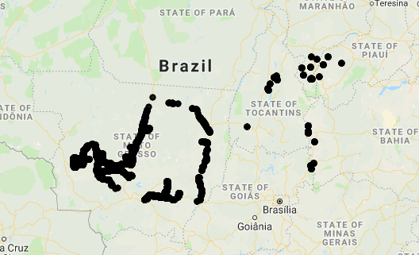
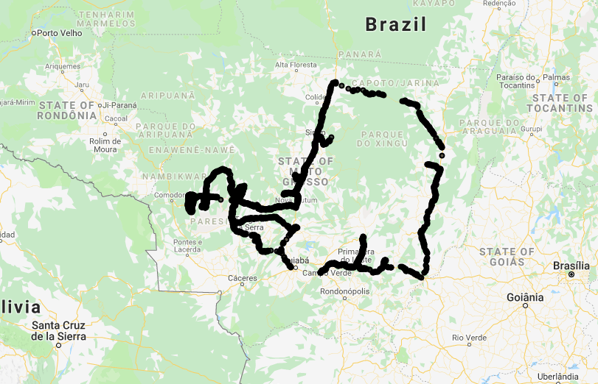
Jake’s original Soy Classification
GEE file: LandCover/Soy Classification Jake mb2_3
Sets of training points:
Kastens training points(kpts) are near roads and only in MT, total 3185 points
‘soy_pts_agsat_1’ are also only in MT, total 21383
‘soy_pts_1’ have some in Matopiba and majority in MT, total 32520
Need more training points across Brazil
How many training points are in Matopiba?
Soy_pts_1
Kastens training pts

Slide 5
Jake’s original Soy Classification
GEE file: LandCover/Soy Classification Jake mb2_3
Inputs to classifier
MODIS aqua 8 day composite, bands 1-5 and 7 between Aug 1 of prev year and Aug 1 of current (classified) year (no extra cloud filtering) (276 per year)
Landsat NDVI 32 day composite (only 10 per year) – note that the original Landsat resolution is still kept in the final classifier image
SRTM (elevation, slope, aspect, hillshade)
‘infill’ all these bands with focal mean. Afterward, the infilled image has less ‘sharp’ gradients and a lower range of values. (purpose is to fill in missing values or to adjust the actual pixel values? Why do we need this?)
Reduce over the infilled classifier images at locations of the soy data points, use ‘sample_infill’ to fill in null values in sampled collection with feature means
Randomly choose 70% to train and 30% to test
Training and testing classifier
Train the classifier on the infilled image
Calculate accuracy of the classifier
Take pre-infilled image, mask with mapbiomas 2.3, and apply classifier to it to get the final classified image

Slide 6
Jake’s original Soy Classification
GEE file: LandCover/Soy Classification Jake mb2_3
MODIS aqua
8-day, B1-5, 7
Aug 1 to Aug 1
Landsat NDVI
32 day, Aug 1 to Aug 1
Elev, slope, aspect, hillshade
class_img
infill
ft_img
Reduce over data points
training pts (70%)
testing pts (30%)
Mask with Mapbio2.3
train
Class_img_ag
Classify image
classifier
accuracy
Final image: classed_img
Legend for classed_img:
Single soy = 0
Double soy = 1
Other agri = 2
Legend for mapbiomas:
Map2.3: agri = 18
Map3: agri = 19

Slide 7
Soy Classification modifications
GEE file: LandCover/Soy Classification Variations
Variations on classification
New training data:
MODIS EVI
Cloud filtered MODIS
Pre classification masking of soy points:
None (original Jake)
Mapbiomas 3
Mapbiomas 3
Post classification masking of classified image:
Mapbiomas 2.3 (original Jake)
Mapbiomas 3
None
Variations on evaluation
Overall accuracy from confusion matrix
Accuracy by region (MT and Matopiba)
Accuracy assuming mb3 is correct (but mb3 only gives agri as a single category)
‘reasonableness’ of timing images

Slide 8
Soy Classification visualization
GEE file: LandCover/Soy Classification Masking
File visually compares classified images to mapbiomas 2.3 and 3
Play with masking out classified image by:
‘uniformity’ of pixels
Reasonableness of crop timing estimates

Slide 9
Land cover classification flow
GEE file: LandCover/Soy Classification Variations
Training data
MODIS EVI
Landsat
SAR
etc
Sample soy points
soy_pts_1
Soy_pts_agsat_1
Classification regions
All
MT
Matopiba
Pre classification soy point filtering
None
Map 2.3
Map 3
classify
Accuracy metrics
Confusion matrix -> acc, consumers/producers acc
Percent agreement with mapbiomas3
Planet labs imagery
Intermediate classified images
GEE file: LandCover/Soy Classification Masking
Additional masking
Homogeneity (based on mapbiomas3)
Reasonableness of timing estimates
Final classified images

Slide 10
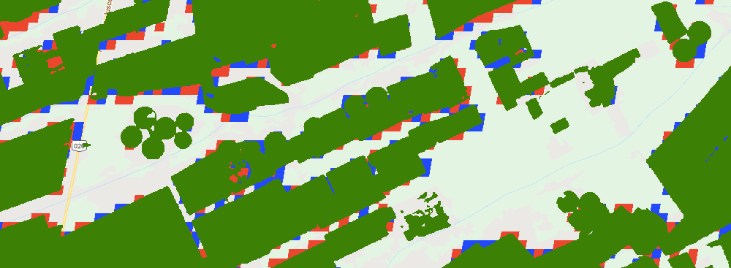
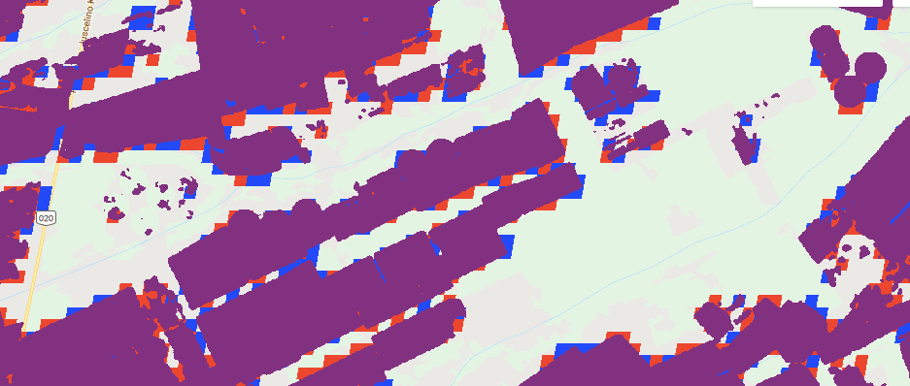
GEE file: LandCover/Soy Classification Masking
Green = mapbiomas 3
Purple = mapbiomas 2.3
Map3 seems to be able to catch center pivot better!

